Slide 1
Encoding / decoding
Example
Message
capracalcapiatranpatrucrapaiarcapulcapreicumacrapatpiatranpatru
Key (permutation)
[3 18 20 1 14 5 4 2 19 13 17 0 23 22 11 9 12 25 15 21 24 8 6 16 7 10]
Encoded message
udjzdudaudjtdvzdwjdvzyuzdjdtdzudjyaudjzotuyxduzdjdvjtdvzdwjdvzy
Problem
?
?
Original message
Key
Encoded message

Slide 2
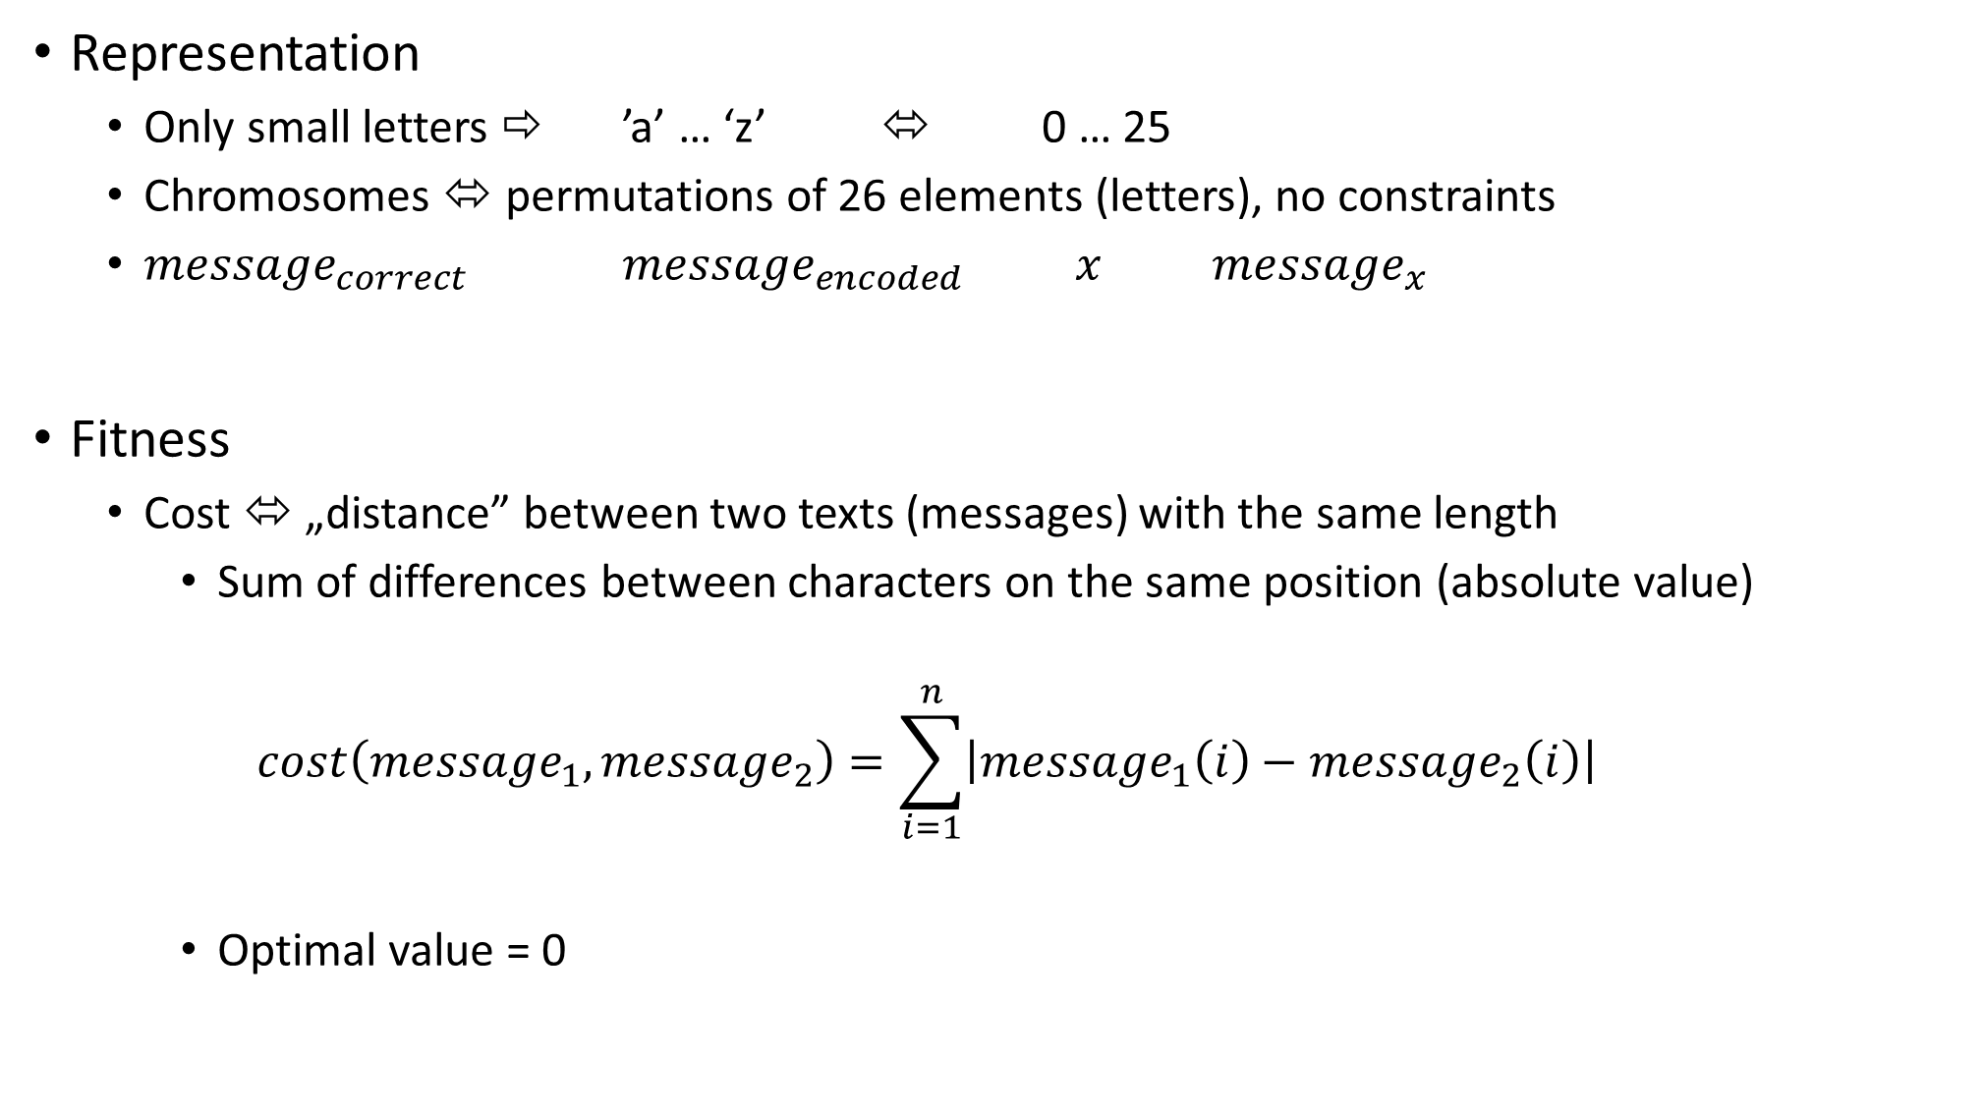
Representation
Only small letters ⇨ ’a’ … ‘z’ ⬄ 0 … 25
Chromosomes ⬄ permutations of 26 elements (letters), no constraints
${message}_{correct}$ ${message}_{encoded}$ $x$ ${message}_{x}$
Fitness
Cost ⬄ „distance” between two texts (messages) with the same length
Sum of differences between characters on the same position (absolute value)
$$cost\left({message}_{1},{message}_{2}\right)=\sum_{i=1}^{n}{\left|{message}_{1}\left(i\right)−{message}_{2}\left(i\right)\right|}$$
Optimal value = 0
Key
Computed message using key x

Slide 3
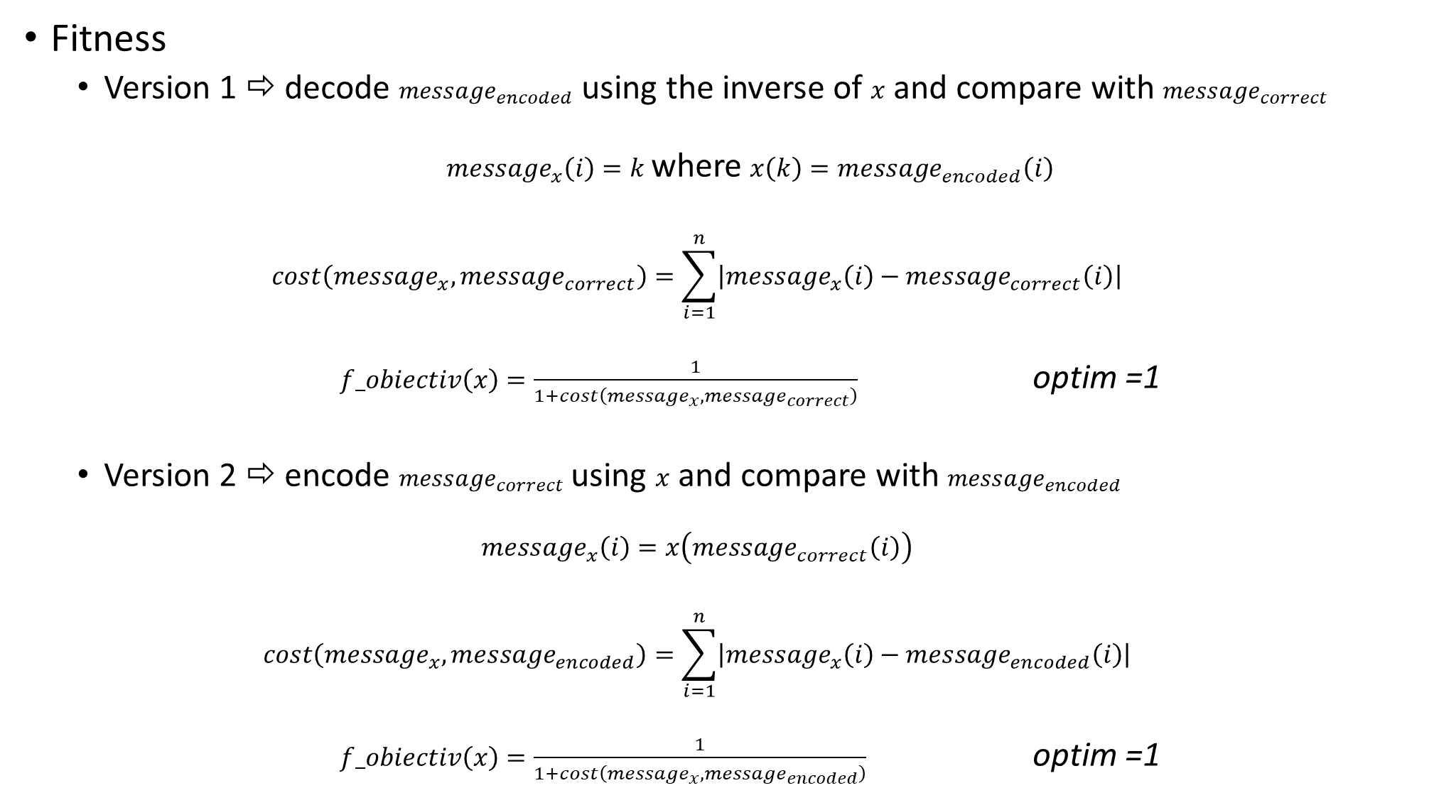
Fitness
Version 1 ⇨ decode ${message}_{encoded}$ using the inverse of $x$ and compare with ${message}_{correct}$
${message}_{x}\left(i\right)=k$ where $x\left(k\right)={message}_{encoded}\left(i\right)$
$$cost\left({message}_{x},{message}_{correct}\right)=\sum_{i=1}^{n}{\left|{message}_{x}\left(i\right)−{message}_{correct}\left(i\right)\right|}$$
$f_obiectiv\left(x\right)=\frac{1}{1+cost\left({message}_{x},{message}_{correct}\right)}$ optim =1
Version 2 ⇨ encode ${message}_{correct}$ using $x$ and compare with ${message}_{encoded}$
$$messa{ge}_{x}\left(i\right)=x\left(messa{ge}_{correct}\left(i\right)\right)$$
$$cost\left({message}_{x},{message}_{encoded}\right)=\sum_{i=1}^{n}{\left|{message}_{x}\left(i\right)−{message}_{encoded}\left(i\right)\right|}$$
$f_obiectiv\left(x\right)=\frac{1}{1+cost\left({message}_{x},{message}_{encoded}\right)}$ optim =1

Slide 4
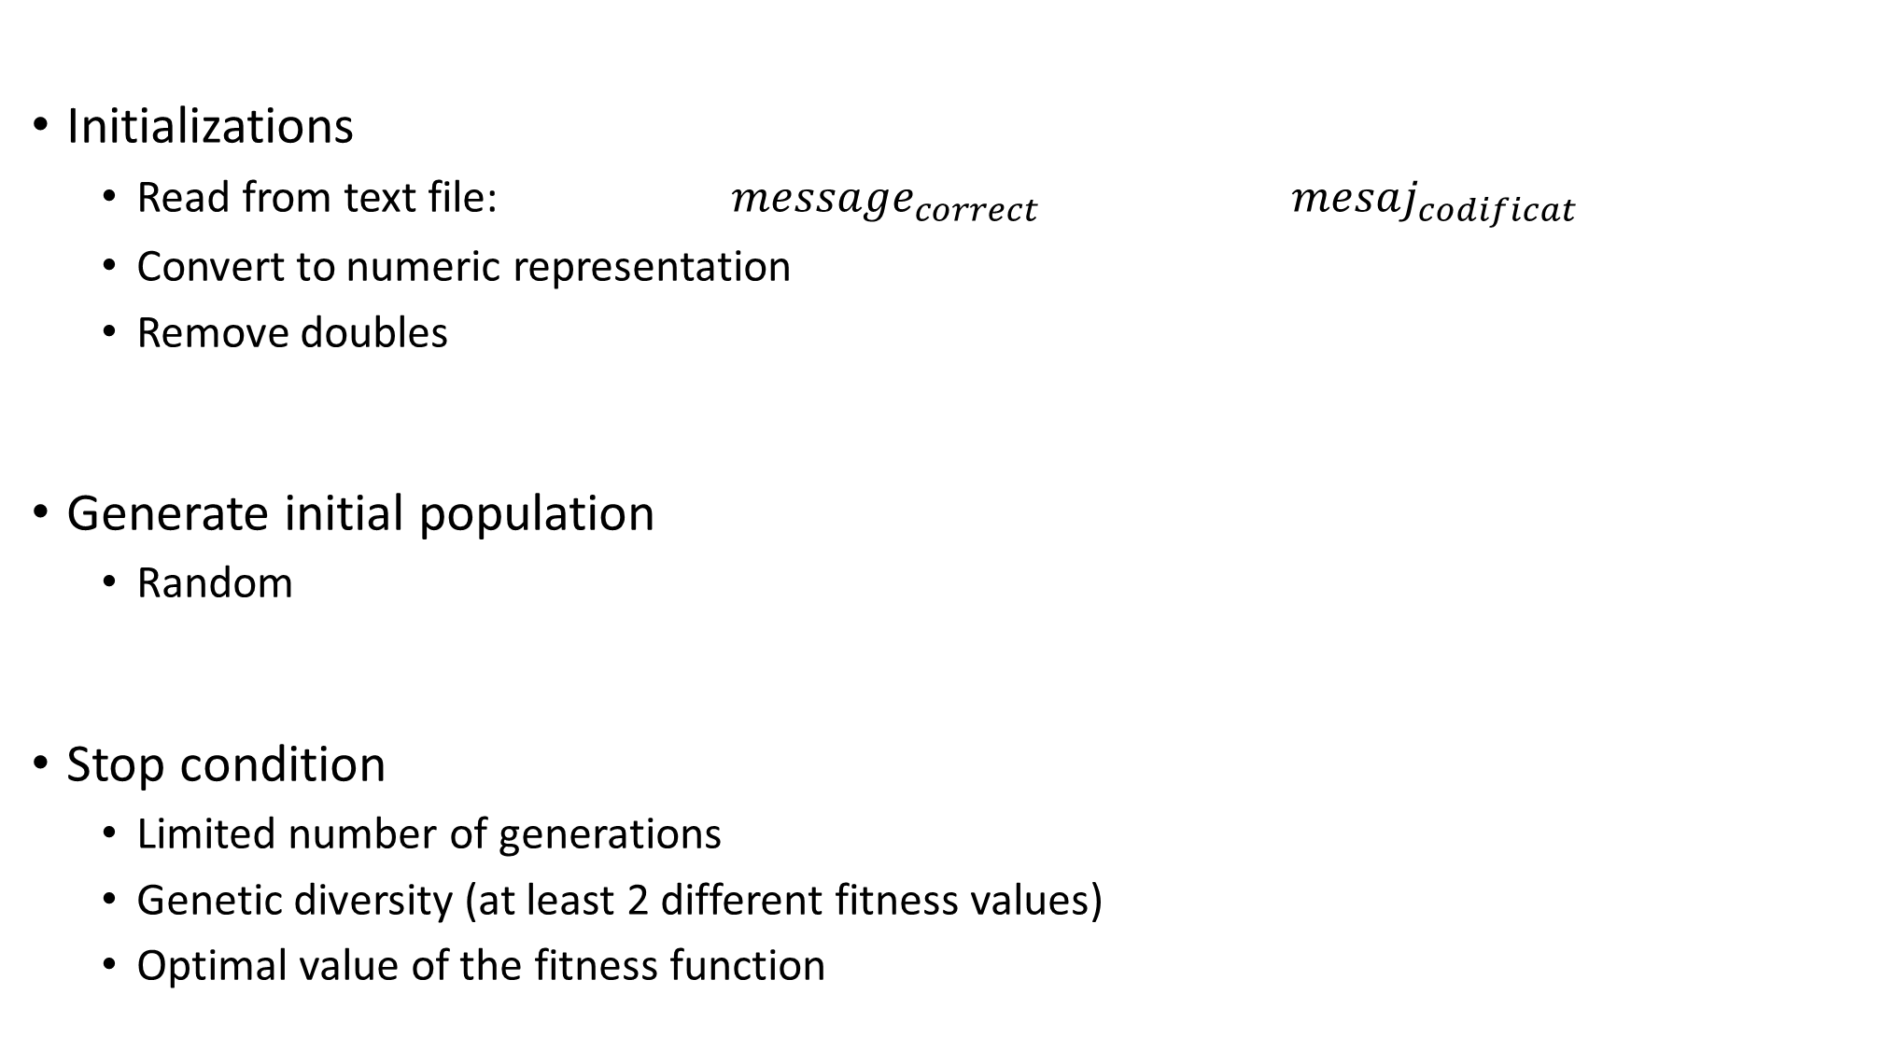
Initializations
Read from text file: ${message}_{correct}$ $mesaj_{codificat}$
Convert to numeric representation
Remove doubles
Generate initial population
Random
Stop condition
Limited number of generations
Genetic diversity (at least 2 different fitness values)
Optimal value of the fitness function

Slide 5
Parent selection
SUS, FPS with sigma-scaling
Crossover
OCX
Mutation
Swap
Selection of next generation
Generational model, age limit 1
Elitism

